Slide 1
Power
Primary Interconnections
120V AC
Digital Data
Analog Signal
Power Supply Box
5V
12V
24V
28V
5V
Salinity Sensor Driver Box
Pressure and Flowrate Sensors Passthrough
Control Valve Driver Box
12V
28V
12V
24V
UART
0-10V (Press.)
Pulse (flowrate)
UART
UART1
A I/O
D I/O
Speedgoat
5V, 12V, 24V, 28V (reference)
A I/O
UART2

Slide 2
Power Supply Box
120V AC
Linear Voltage Regulated Board
Banana plug sockets
28V
Linear Power Supply
28V
DC Ground
5V
12V
24V
28V
DB9_0 pinout:
5V DC (1/3 gain)
12V DC (1/3 gain)
24V DC (1/3 gain)
28V DC (1/3 gain)
5-9. DC ground
1/3
1/3
1/3
1/3
1
2
3
4
5-9
5V
12V
24V
28V
DB9_0
5.5mm x 2.1mm barrel jack sockets

Slide 3
120V AC
Power Supply Box
Mad Hornets 12V → 28V Converter
Meanwell RT-50D PSU
DB9_0 pinout:
5V DC (1/3 gain)
12V DC (1/3 gain)
24V DC (1/3 gain)
28V DC (1/3 gain)
5-9. DC ground
DC Ground
12V
28V
24V
12V
5V
120V
1/3
1/3
1/3
1/3
1
2
3
4
5-9
5V
12V
24V
28V
DB9_0
5.5mm x 2.1mm barrel jack sockets

Slide 4
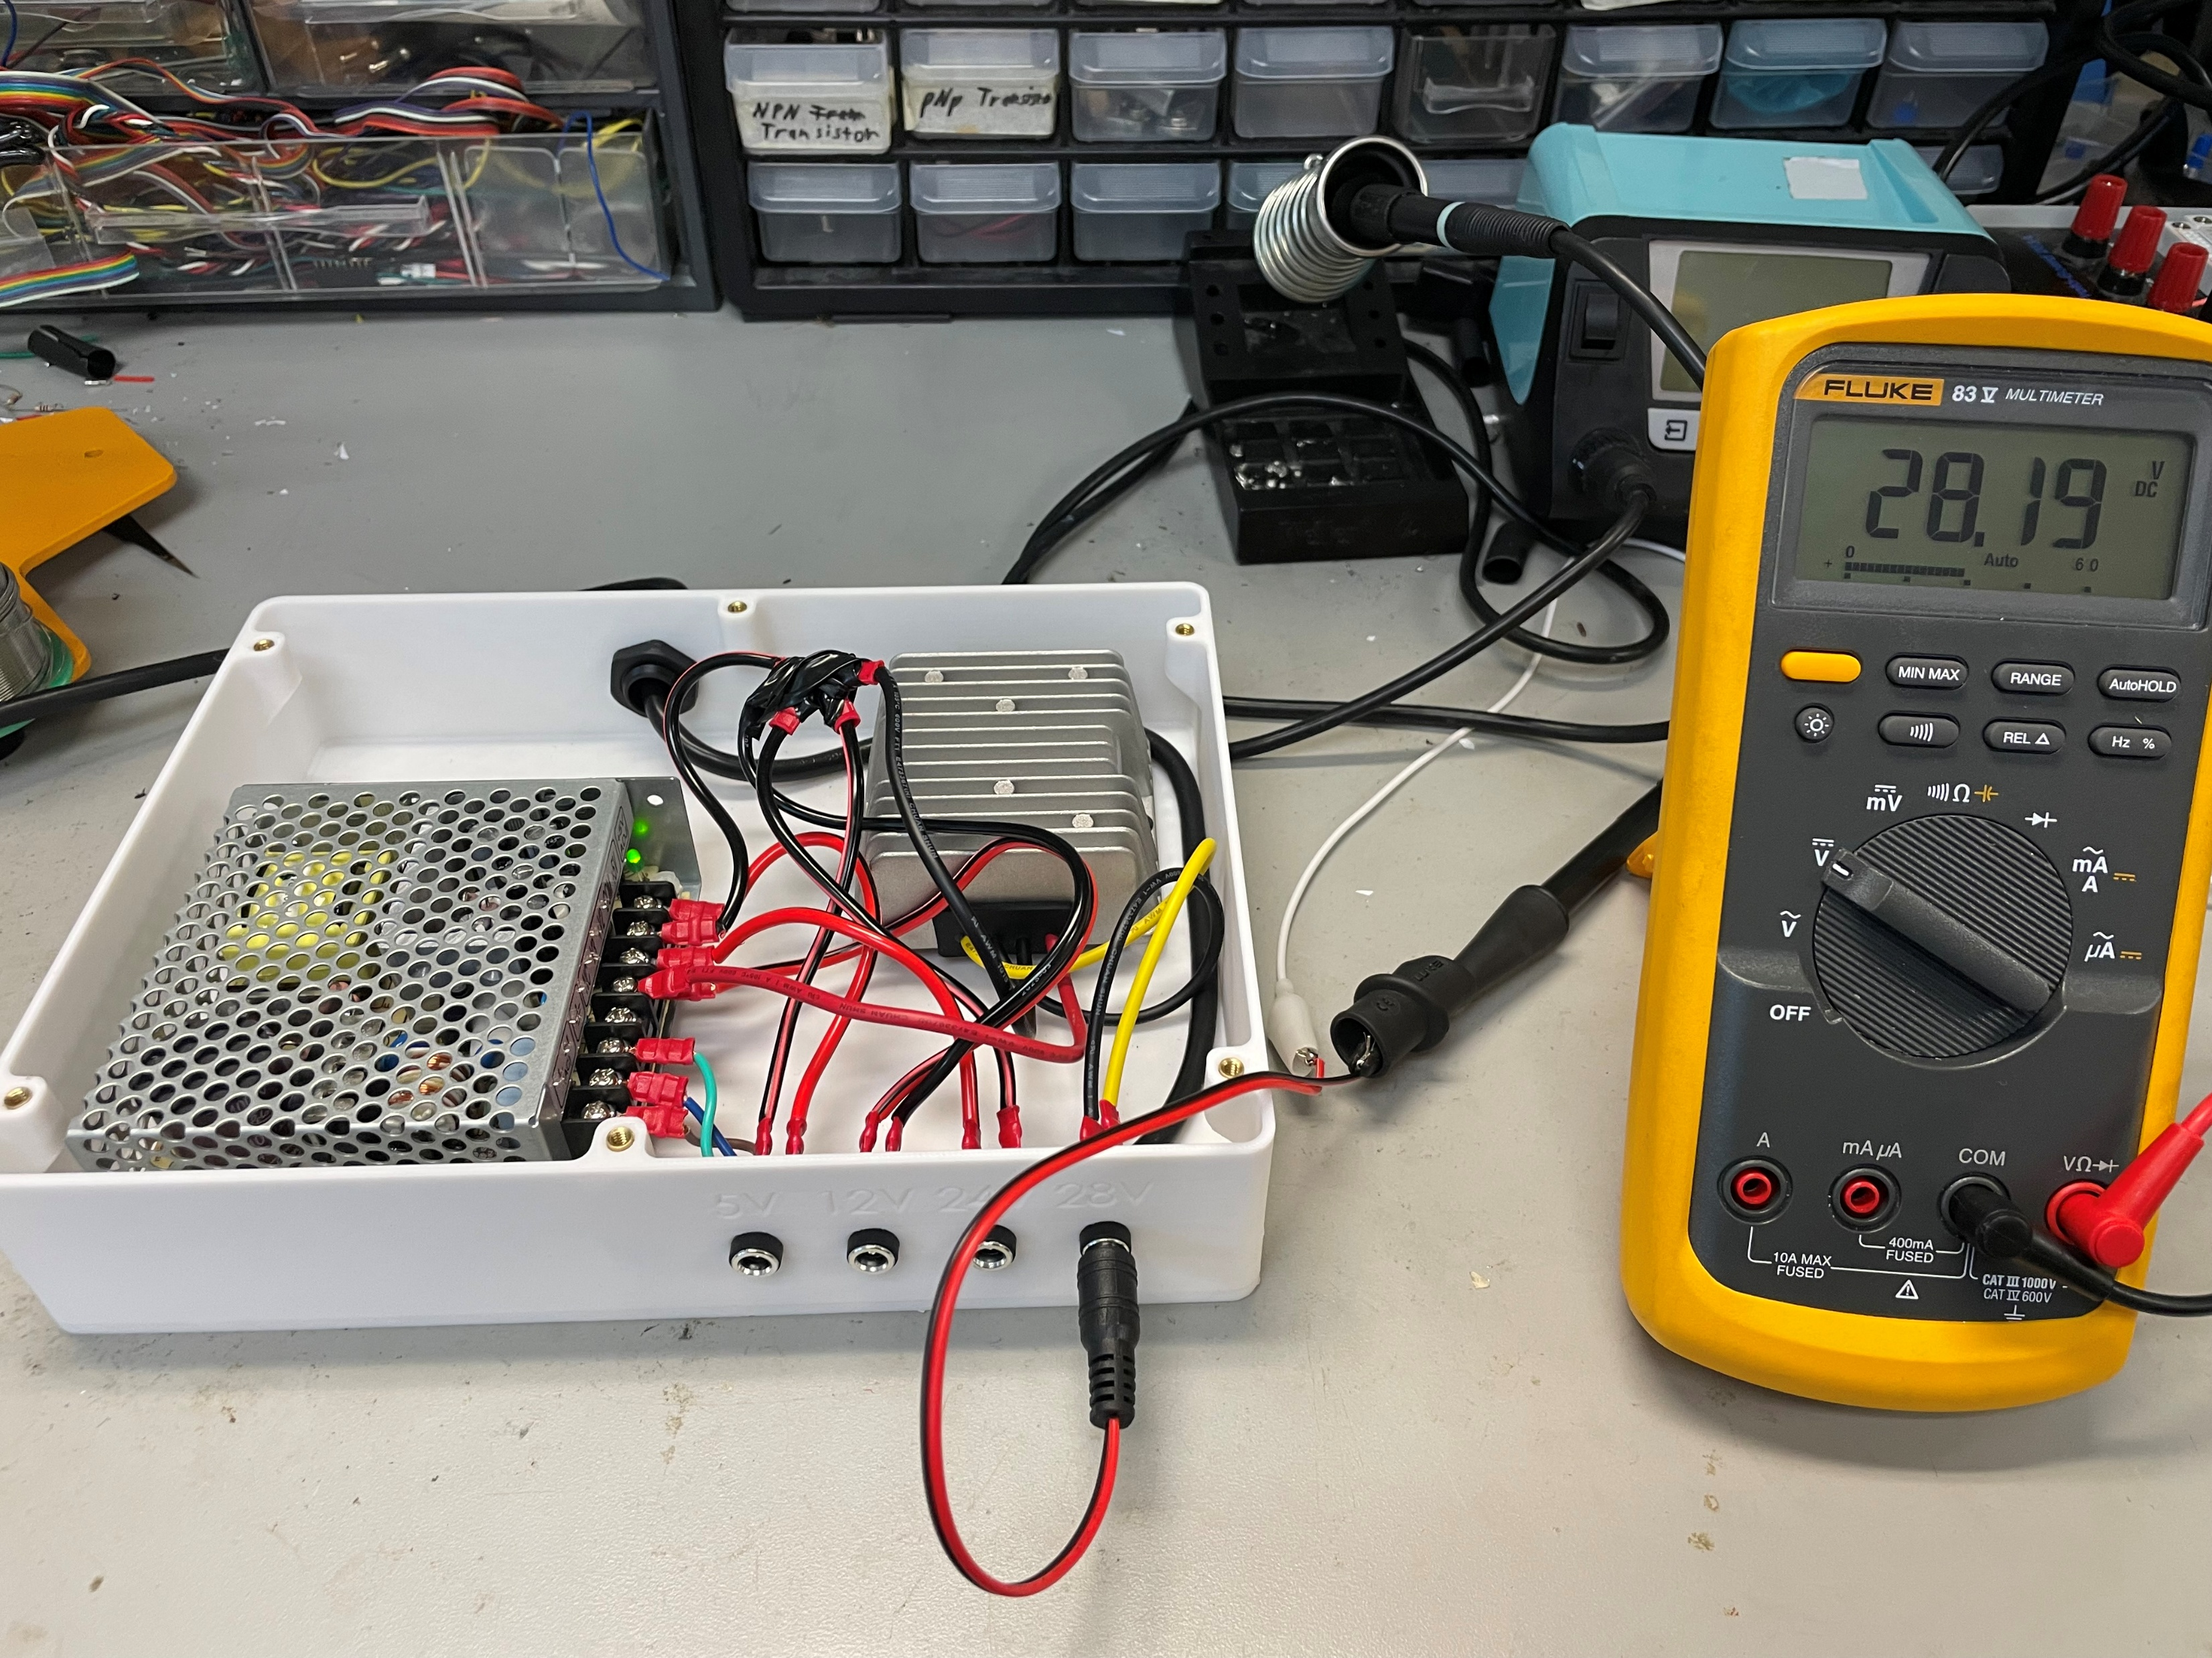
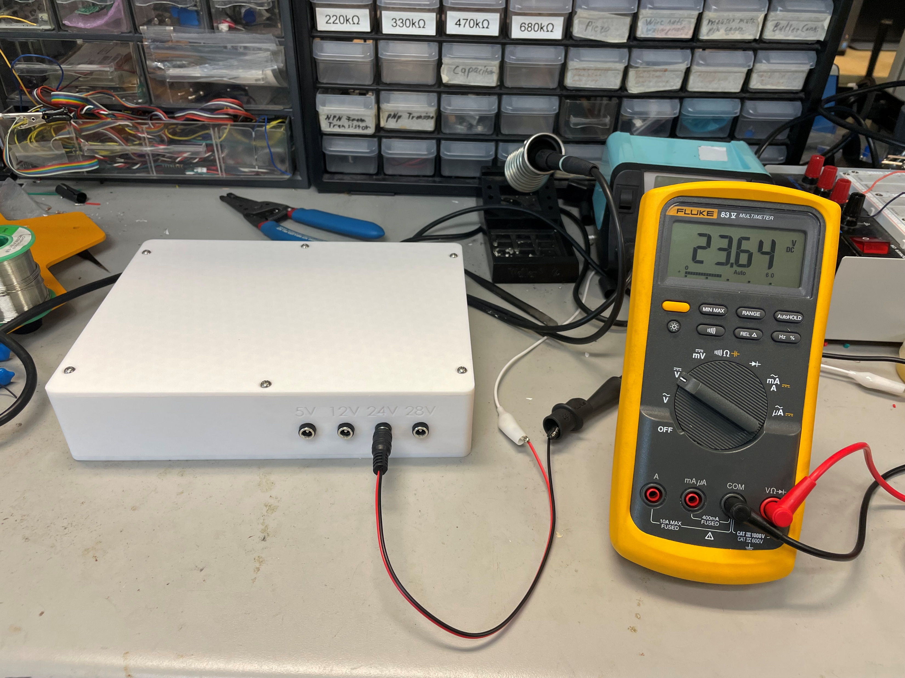
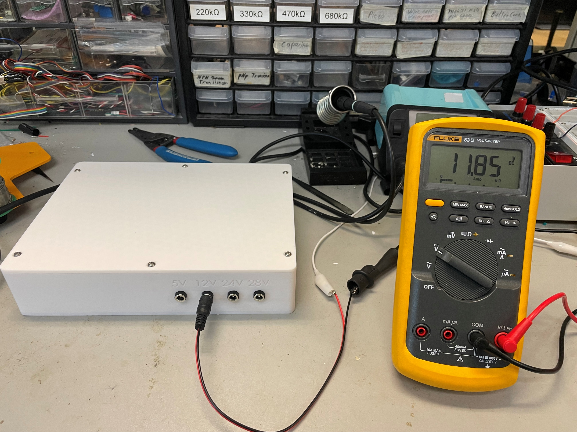
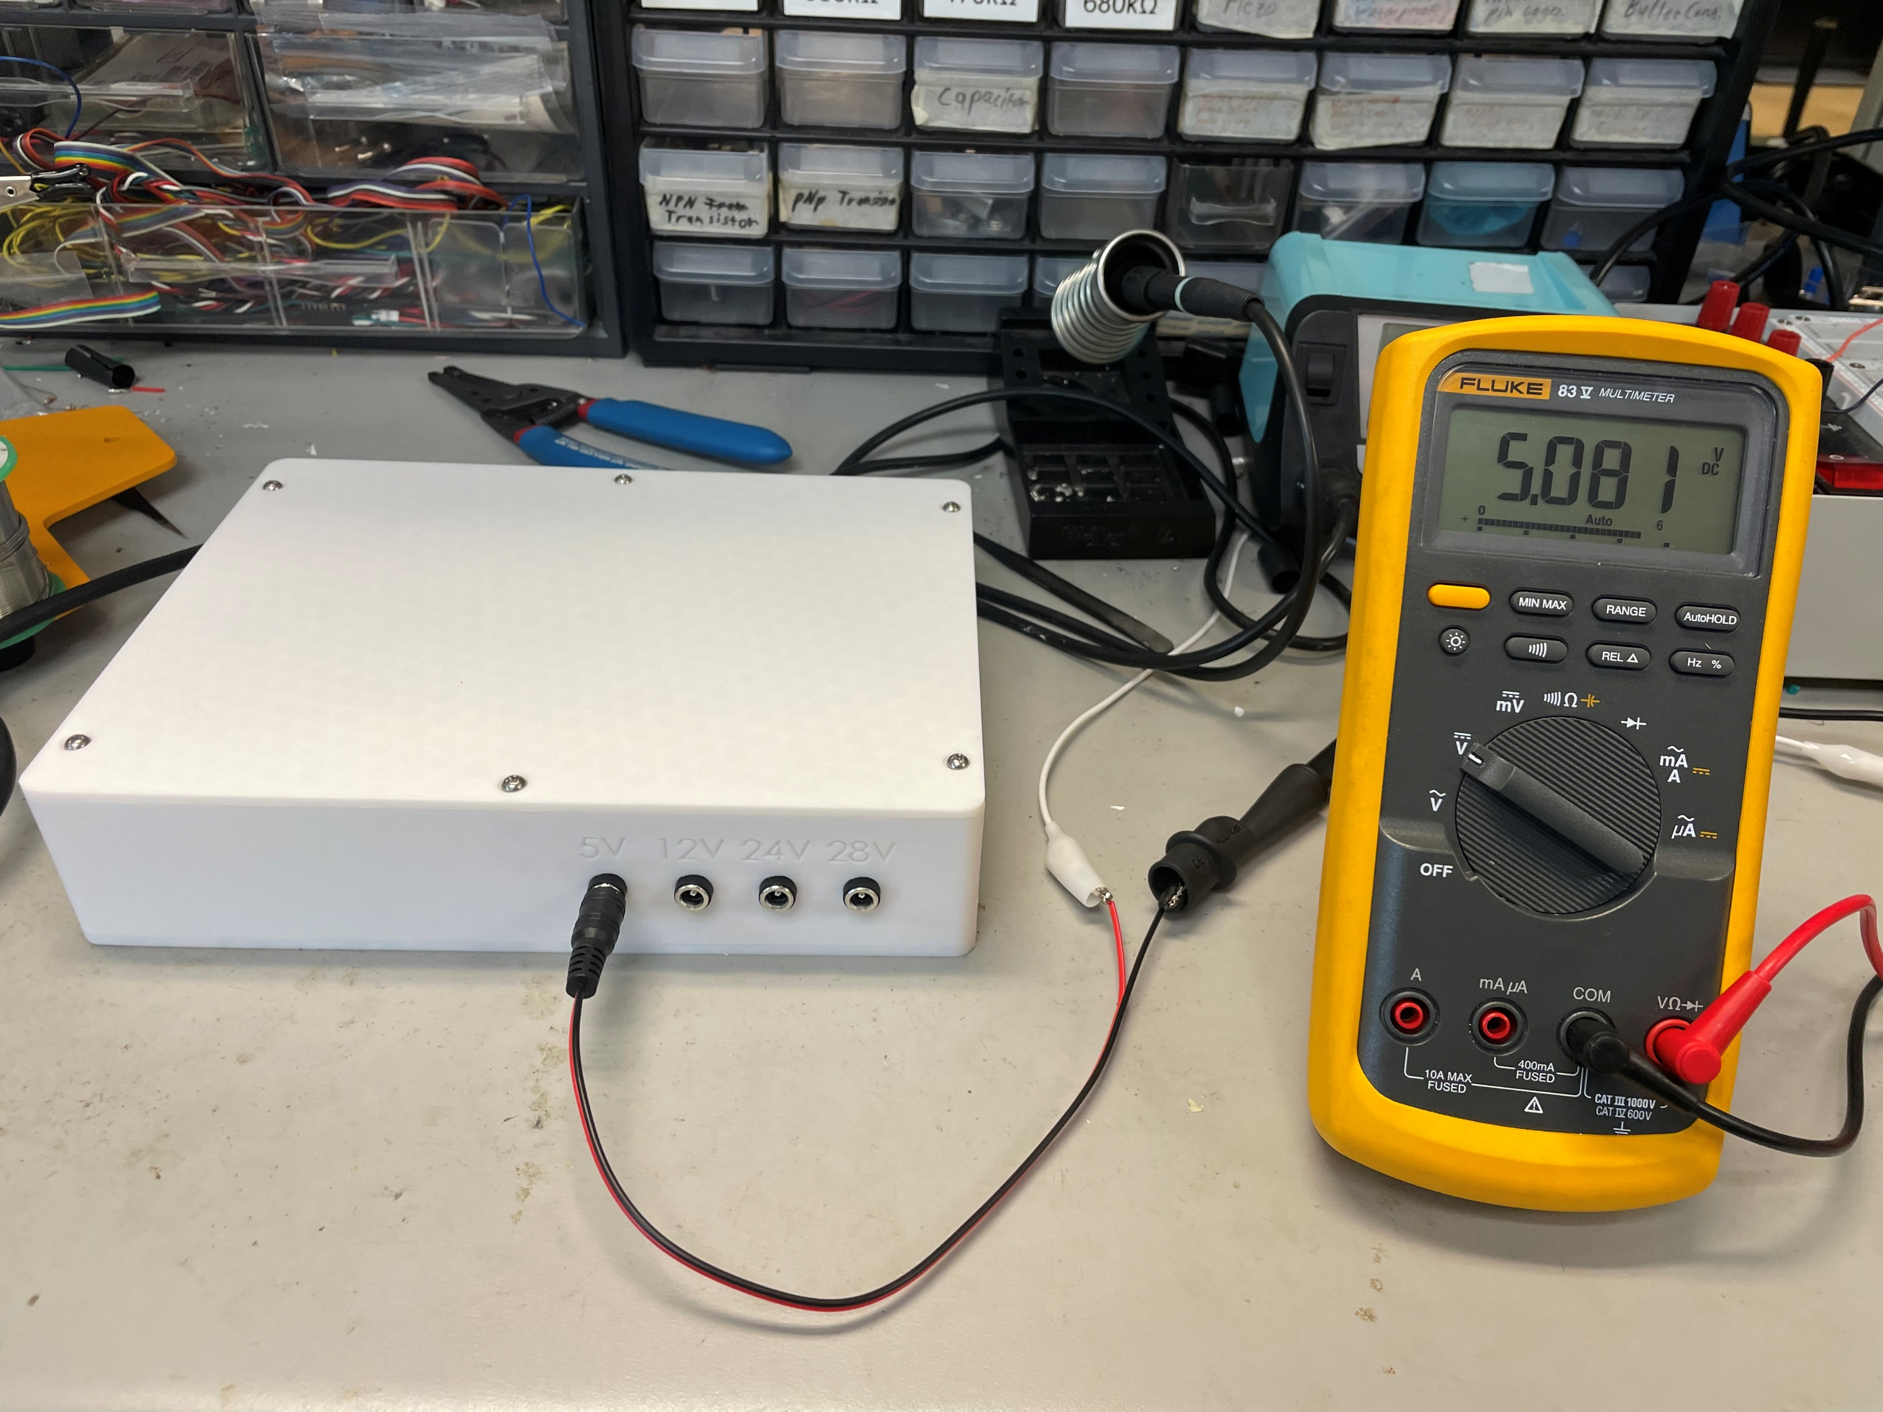

Slide 5
Power
Salinity Sensor Driver Box
Digital Data
Breadboard
UART (USB)
Speedgoat
Arduino
UART
I2C
PSU Box
5V
EZO Temp. Driver Board
EZO Temp. Driver Board
5V
I2C
5V
I2C
EZO Cond. Driver Board
EZO Temp. Driver Board
5V
I2C
EZO Cond. Driver Board
5V
I2C
5V
I2C
EZO Cond. Driver Board
5V
I2C
SMA screw connectors
Sensor 1
Sensor 2
Sensor 3

Slide 6
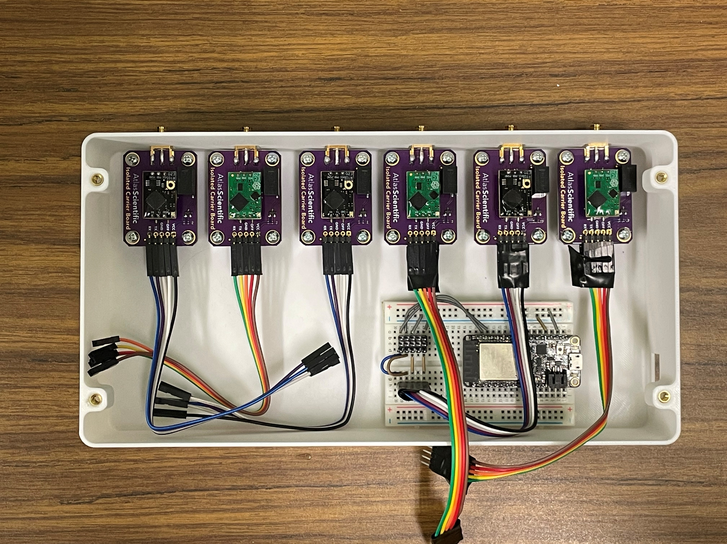

Slide 7
Pressure and Flowrate Sensors Passthrough
5.5mm x 2.1mm barrel jack sockets
Protoboard
PSU Box
12V
PSU Box
28V
DB9_1 pinout:
0-10V, Press. 1
0-10V, Press. 2
0-10V, Press. 3
5V Pulse, Flow 1
5V Pulse, Flow 2
5V Pulse, Flow 3
5V Pulse, Flow 4
0-10V, Flow 5
Ground
1
2
3
4
5
DB9_1
6
7
8
9
Press 1
Press 2
Press 3
Flow 1
Flow 2
Flow 3
Flow 4
Flow 5
4 pin waterproof AMP connectors

Slide 8
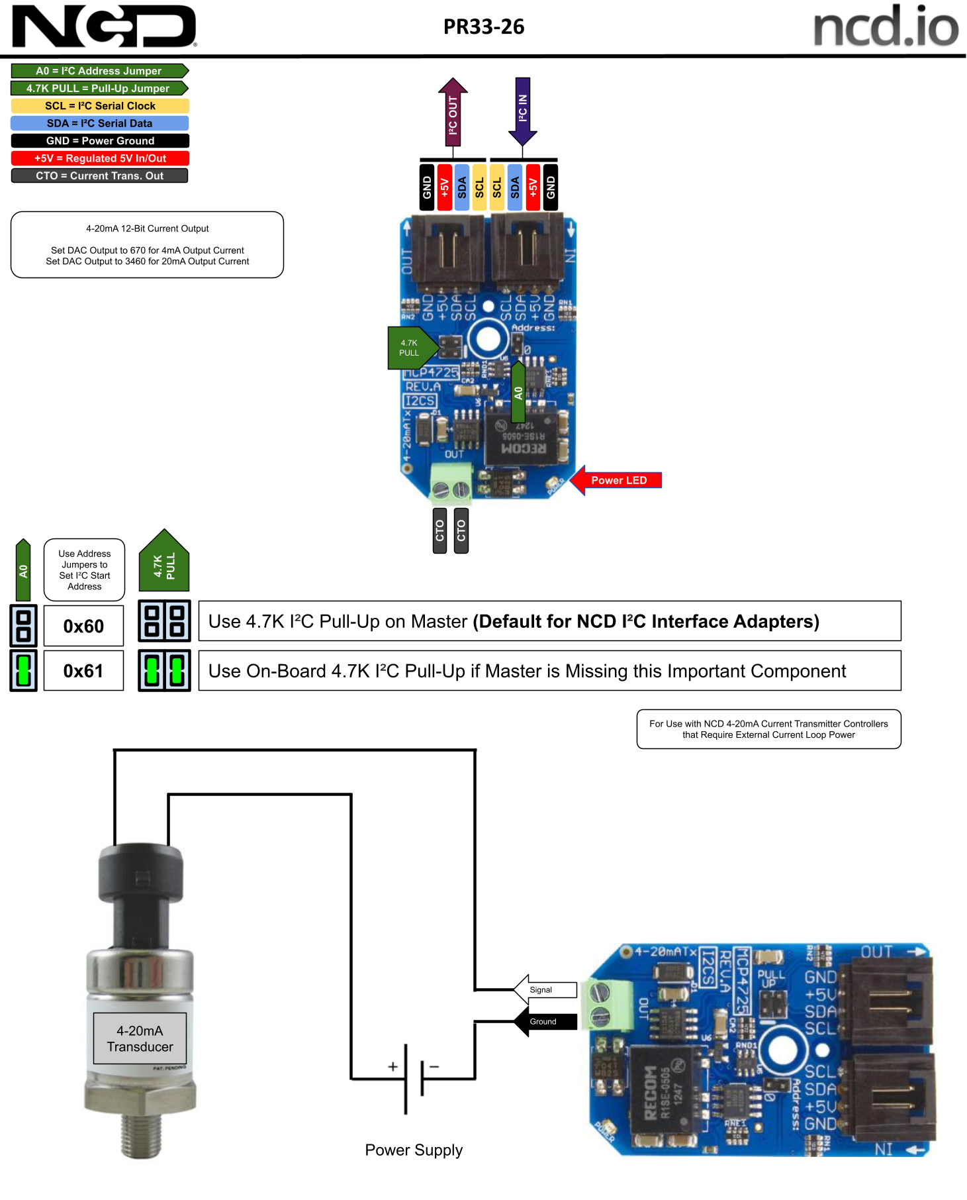
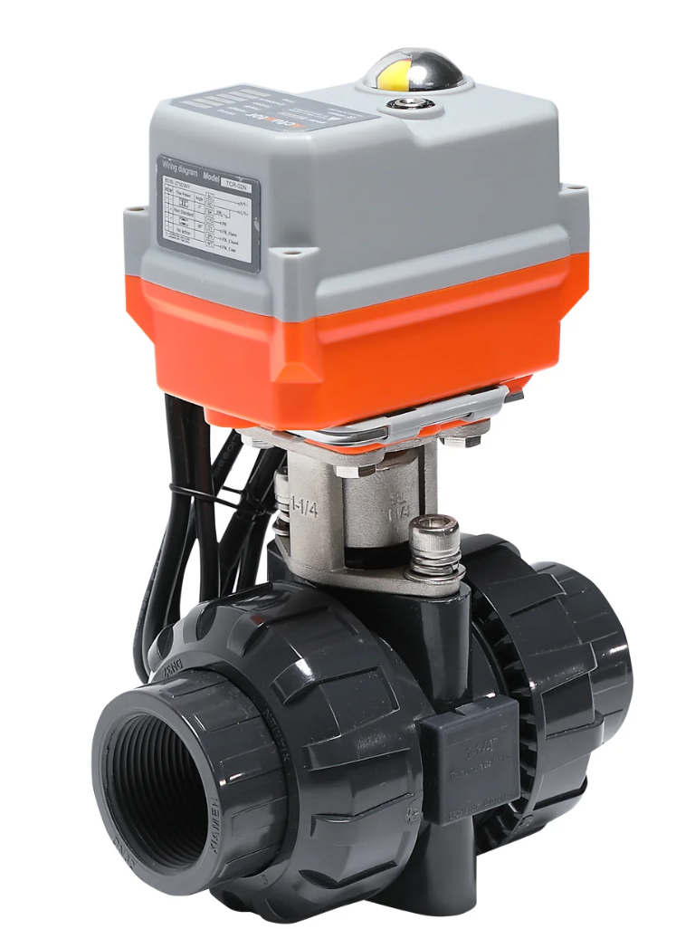
Control Valve Driver Box
5.5mm x 2.1mm barrel jack sockets
Breadboard
PSU Box
12V
PSU Box
24V
Speedgoat
Arduino Uno
w/ I2C Hat
UART
I2C
UART (USB)
NCD 4-20 mA I2C transmitter

Slide 9
DB9_1 pinout:
0-10V, Press. 1
0-10V, Press. 2
0-10V, Press. 3
5V Pulse, Flow 1
5V Pulse, Flow 2
5V Pulse, Flow 3
5V Pulse, Flow 4
0-10V, Flow 5
Ground
Speedgoat Breakout Box
1
1a
2
5a
2a
3
3a
6a
4
7a
5
4a
IO191
DB9_1
8a
6
17a
7
1b
2b
8
3b
9
4b
9a
10a
11a
12a
DB9_0 pinout:
5V DC (1/3 gain)
12V DC (1/3 gain)
24V DC (1/3 gain)
28V DC (1/3 gain)
5-9. DC ground
1
2
1a*
3
3a*
DB9_0
5a*
4
7a*
IO397
5
13a
17a
Analog Ground Bus Bar
AI1^
AI2^
AI3^
AI4^
AO1^
AO2^
AO3^
AO4^
*Connect IO397 2a, 4a, 6a, and 8a to analog ground (13a, 14a, or 17a).
^AI1-4 and A01-4 are RCA sockets. Connect ground to analog ground bus bar. Unused analog pins must be connected to analog ground.

Slide 10
DB9_1 pinout:
0-10V, Press. 1 → IO191, 1a
0-10V, Press. 2 → IO191, 2a
0-10V, Press. 3 → IO191, 3a
5V Pulse, Flow 1 → IO191, 1b
5V Pulse, Flow 2 → IO191, 2b
5V Pulse, Flow 3 → IO191, 3b
5V Pulse, Flow 4 → IO191, 4b
0-10V, Flow 5 → IO191, 4a
Ground → IO191, 13a
IO191 mapping:
1a: Pressure sensor 1, 0-10V
2a: Pressure sensor 2, 0-10V
3a: Pressure sensor 3, 0-10V
4a: Flowrate sensor 5, 0-10V
5a: External analog input 1 (load cell)
6a: External analog input 2 (LVDT)
7a: External analog input 3 (ground unless used)
8a: External analog input 4 (ground unless used)
9a: External analog output 1 (DLE control valve)
10a: External analog output 2
11a: External analog output 3
12a: External analog output 4
13a: DB9_1 ground
14a: Connect to IO191 pin 17b
17a: Connect to IO397 pin 17a
1b: Flowrate sensor 1, 5V pulse
2b: Flowrate sensor 2, 5V pulse
3b: Flowrate sensor 3, 5V pulse
4b: Flowrate sensor 4, 5V pulse
17b: Connect to IO191 pin 14a
IO397 mapping:
1a: 5V DC reference (1/3 gain)
2a: 12V DC reference (1/3 gain)
3a: 24V DC reference (1/3 gain)
4a: 28V DC reference (1/3 gain)
13a: DB9_0 ground
17a: Connect to IO191 pin 17a
DB9_0 pinout:
5V DC (1/3 gain) → IO397, 1a
12V DC (1/3 gain) → IO397, 3a
24V DC (1/3 gain) → IO397, 5a
28V DC (1/3 gain) → IO397, 7a
5-9. DC ground → IO397, 13a

Slide 11
Shopping list:
7-pin JST sockets
DB9 sockets
Four-conductor wire
Protoboards
3x Teensy 4.1
6-32 x 0.25” heat-set inserts
6-32 SHC screws
Crimp butt connectors
Soldering iron tips

